Slide 1

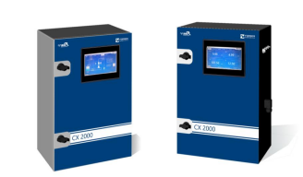
CX2000 On-line Continuous Effluent Monitoring System: Training

Slide 2
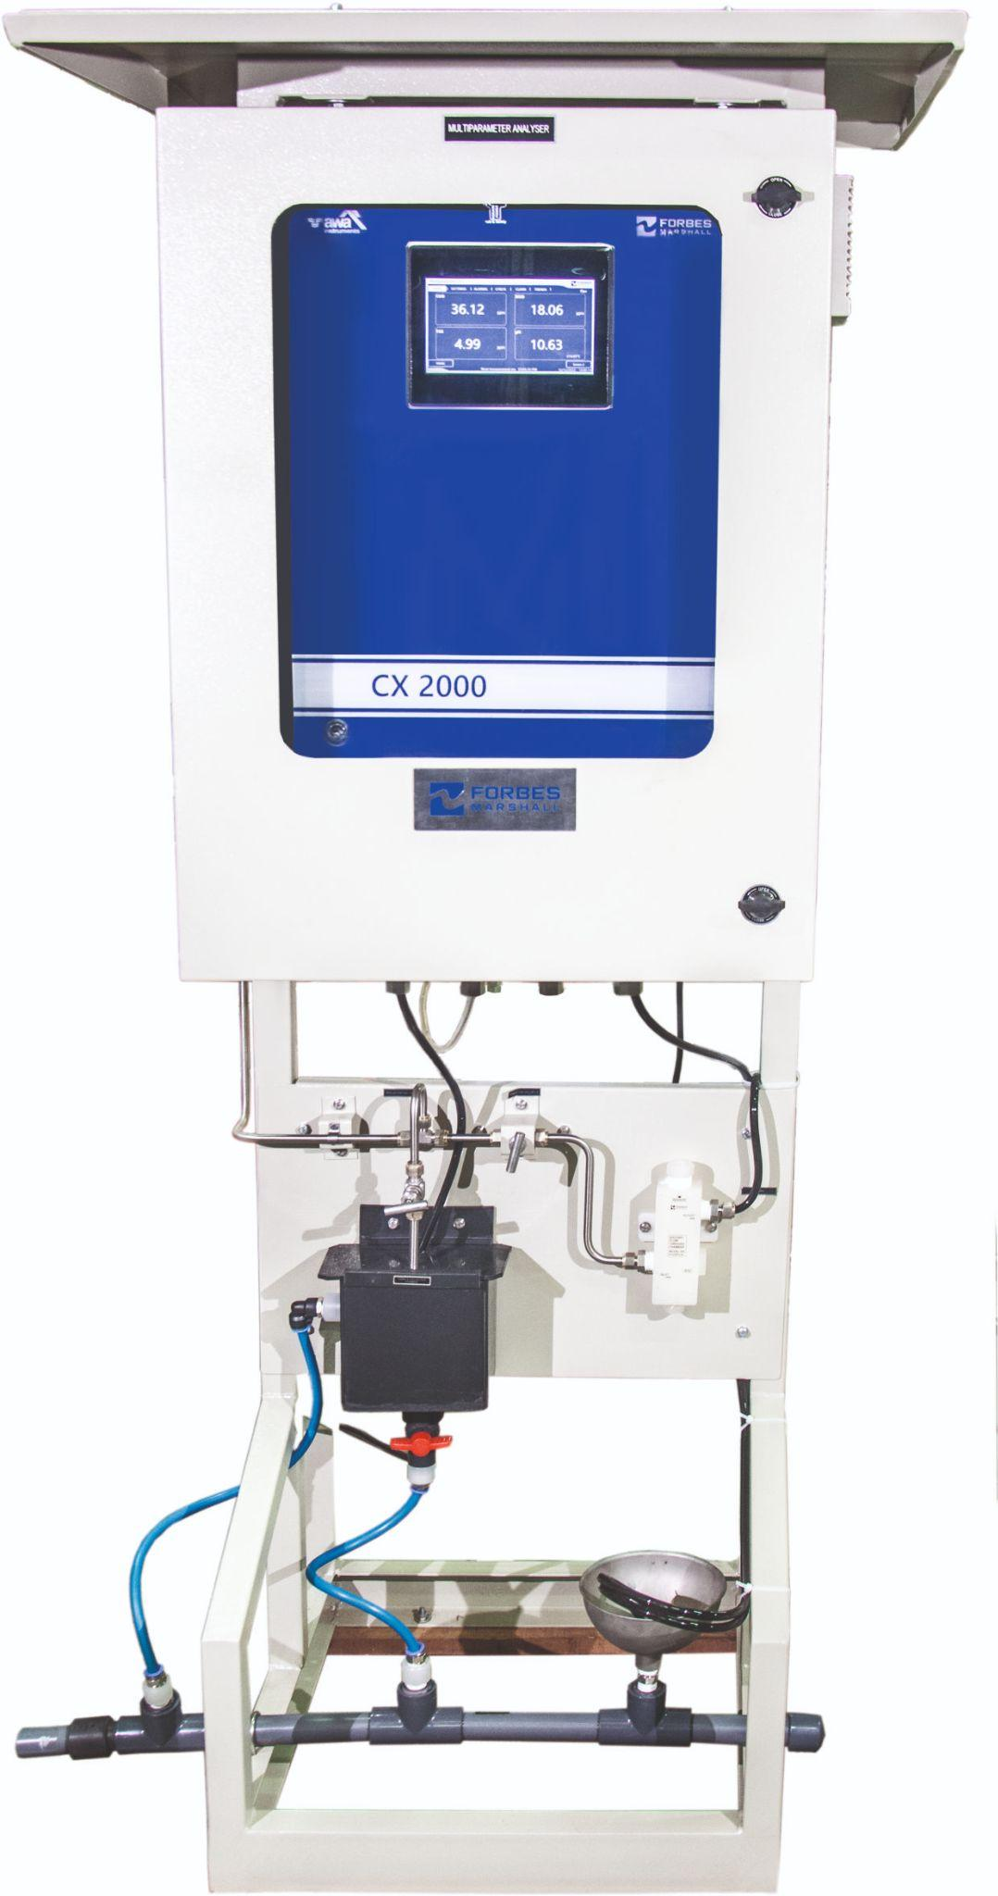
Introduction
CX2000 is a multi-parameter on-line continuous water quality monitoring analyser
Parameters | Technology
COD, TSS | UV-Vis Absorption
BOD, TOC | Calculated from COD
pH | Glass Electrode Method

Slide 3
Ranges in Different Models
Model No. | 3912 | 3922 | 3932 | 3952
Flow Cell Path Length (in mm) | 10 | 5 | 3 | 2
COD Range (in mg/L) | 0 - 300 | 0 - 800 | 0 - 2000 | 0 - 5000
TSS Range (in mg/L) | 0 - 450 | 0 - 750 | 0 - 1500 | 0 - 2500
pH Range | 0 - 14 | 0 - 14 | 0 - 14 | 0 - 14
BOD Range (in mg/L) [BOD = 0.5 * COD] | 0 - 150 | 0 - 400 | 0 - 1000 | 0 - 2500
TOC Range (in mg/L) [TOC = 0.33 * COD] | 0 - 99 | 0 - 264 | 0 - 660 | 0 - 1650

Slide 4
WHAT is COD
What is Chemical Oxygen Demand (COD)?
Chemical oxygen demand (COD) is the amount of dissolved oxygen that must be present in water to oxidize chemical organic materials, like petroleum. COD is used to gauge the short-term impact wastewater effluents will have on the oxygen levels of receiving waters.
Why Measure Chemical Oxygen Demand (COD)?
When treated wastewater is discharged into the environment, it can introduce pollution in the form of organic content to receiving waters. High levels of wastewater COD indicate concentrations of organics that can deplete dissolved oxygen in the water, leading to negative environmental and regulatory consequences. To help determine the impact and ultimately limit the amount of organic pollution in water, oxygen demand is an essential measurement.

Slide 5
WHAT is BOD
What is Biological Oxygen Demand? (BOD)
Biological Oxygen Demand is defined as the amount of dissolved oxygen required by aerobic microorganisms to breakdown the organic materials in a sample of water at a specific temperature & timeframe. In simpler words, The amount of oxygen needed by biological organisms such as bacteria in a given water sample for a breakdown of organic matter by oxidation process is called the Biochemical Oxygen Demand.

Slide 6
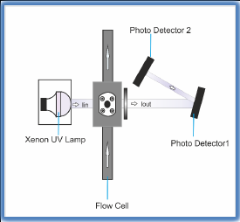
Measurement Principle
COD, TSS: The measurement principle is based on Beer – Lambert Law
c = K log(I in/ I out)
c = sample concentration
K = absorption coefficient
I in = light intensity at the input of the sample
I out = light intensity at the output of the sample
Compliant with CPCB Guideline, DIN 38404-3 Standard

Slide 7
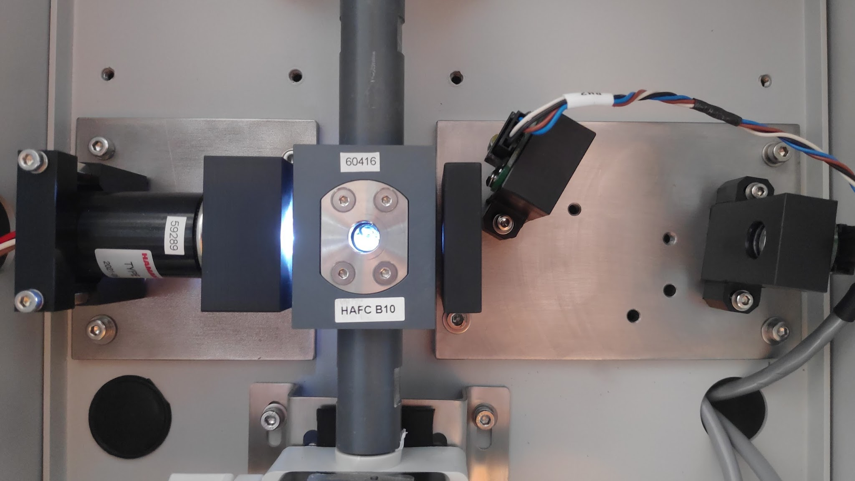
Photodetector 2 (for TSS measurement and Turbidity compensation of COD)
Light source
Flow cell
Photodetector 1 (for COD measurement)
Light guide (aperture)

Slide 9
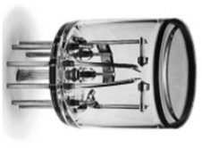
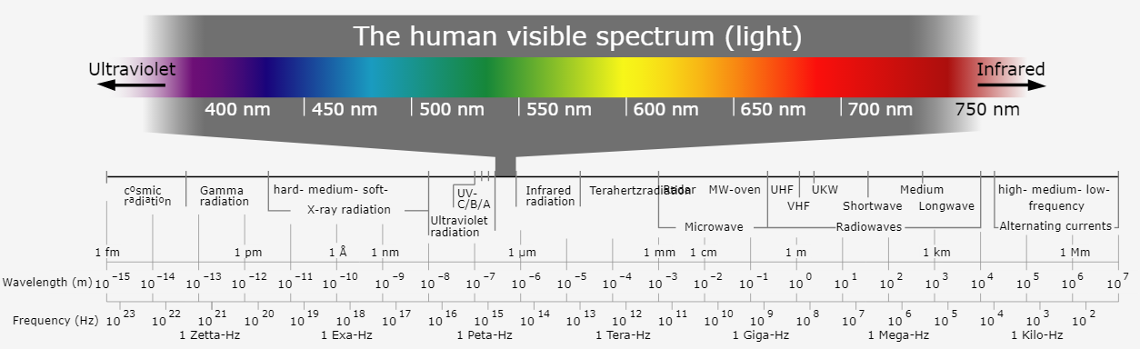
Sample outlet
Only green light at 550 nm
Only invisible UV light at 254 nm
550 nm Bandpass filter
Flow cell
254 nm Bandpass filter
Xenon Flash Lamp
(white flashing bulb)
Sample inlet

Slide 10
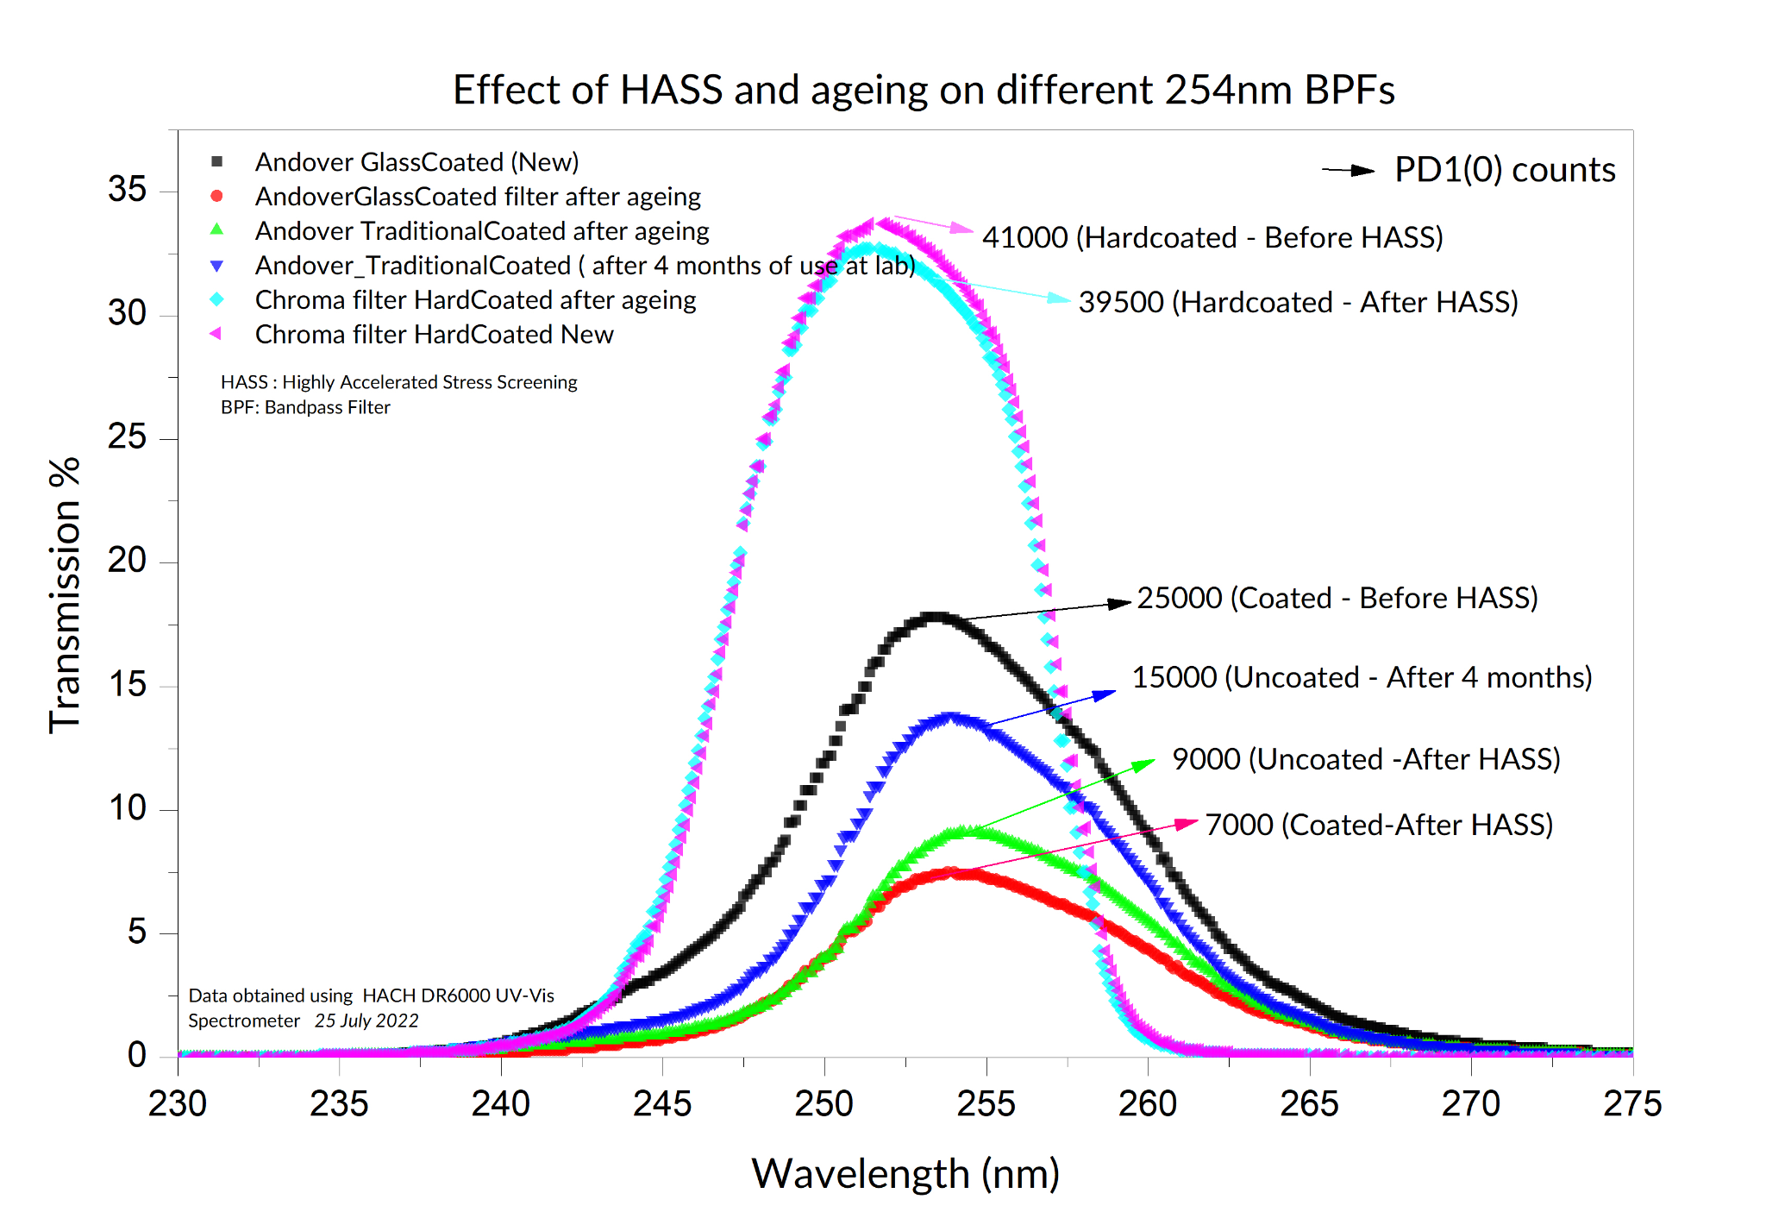
Hard-Coated vs. Traditional-Coated Optical Filter
Hard-Coated
Traditional-Coated

Slide 11
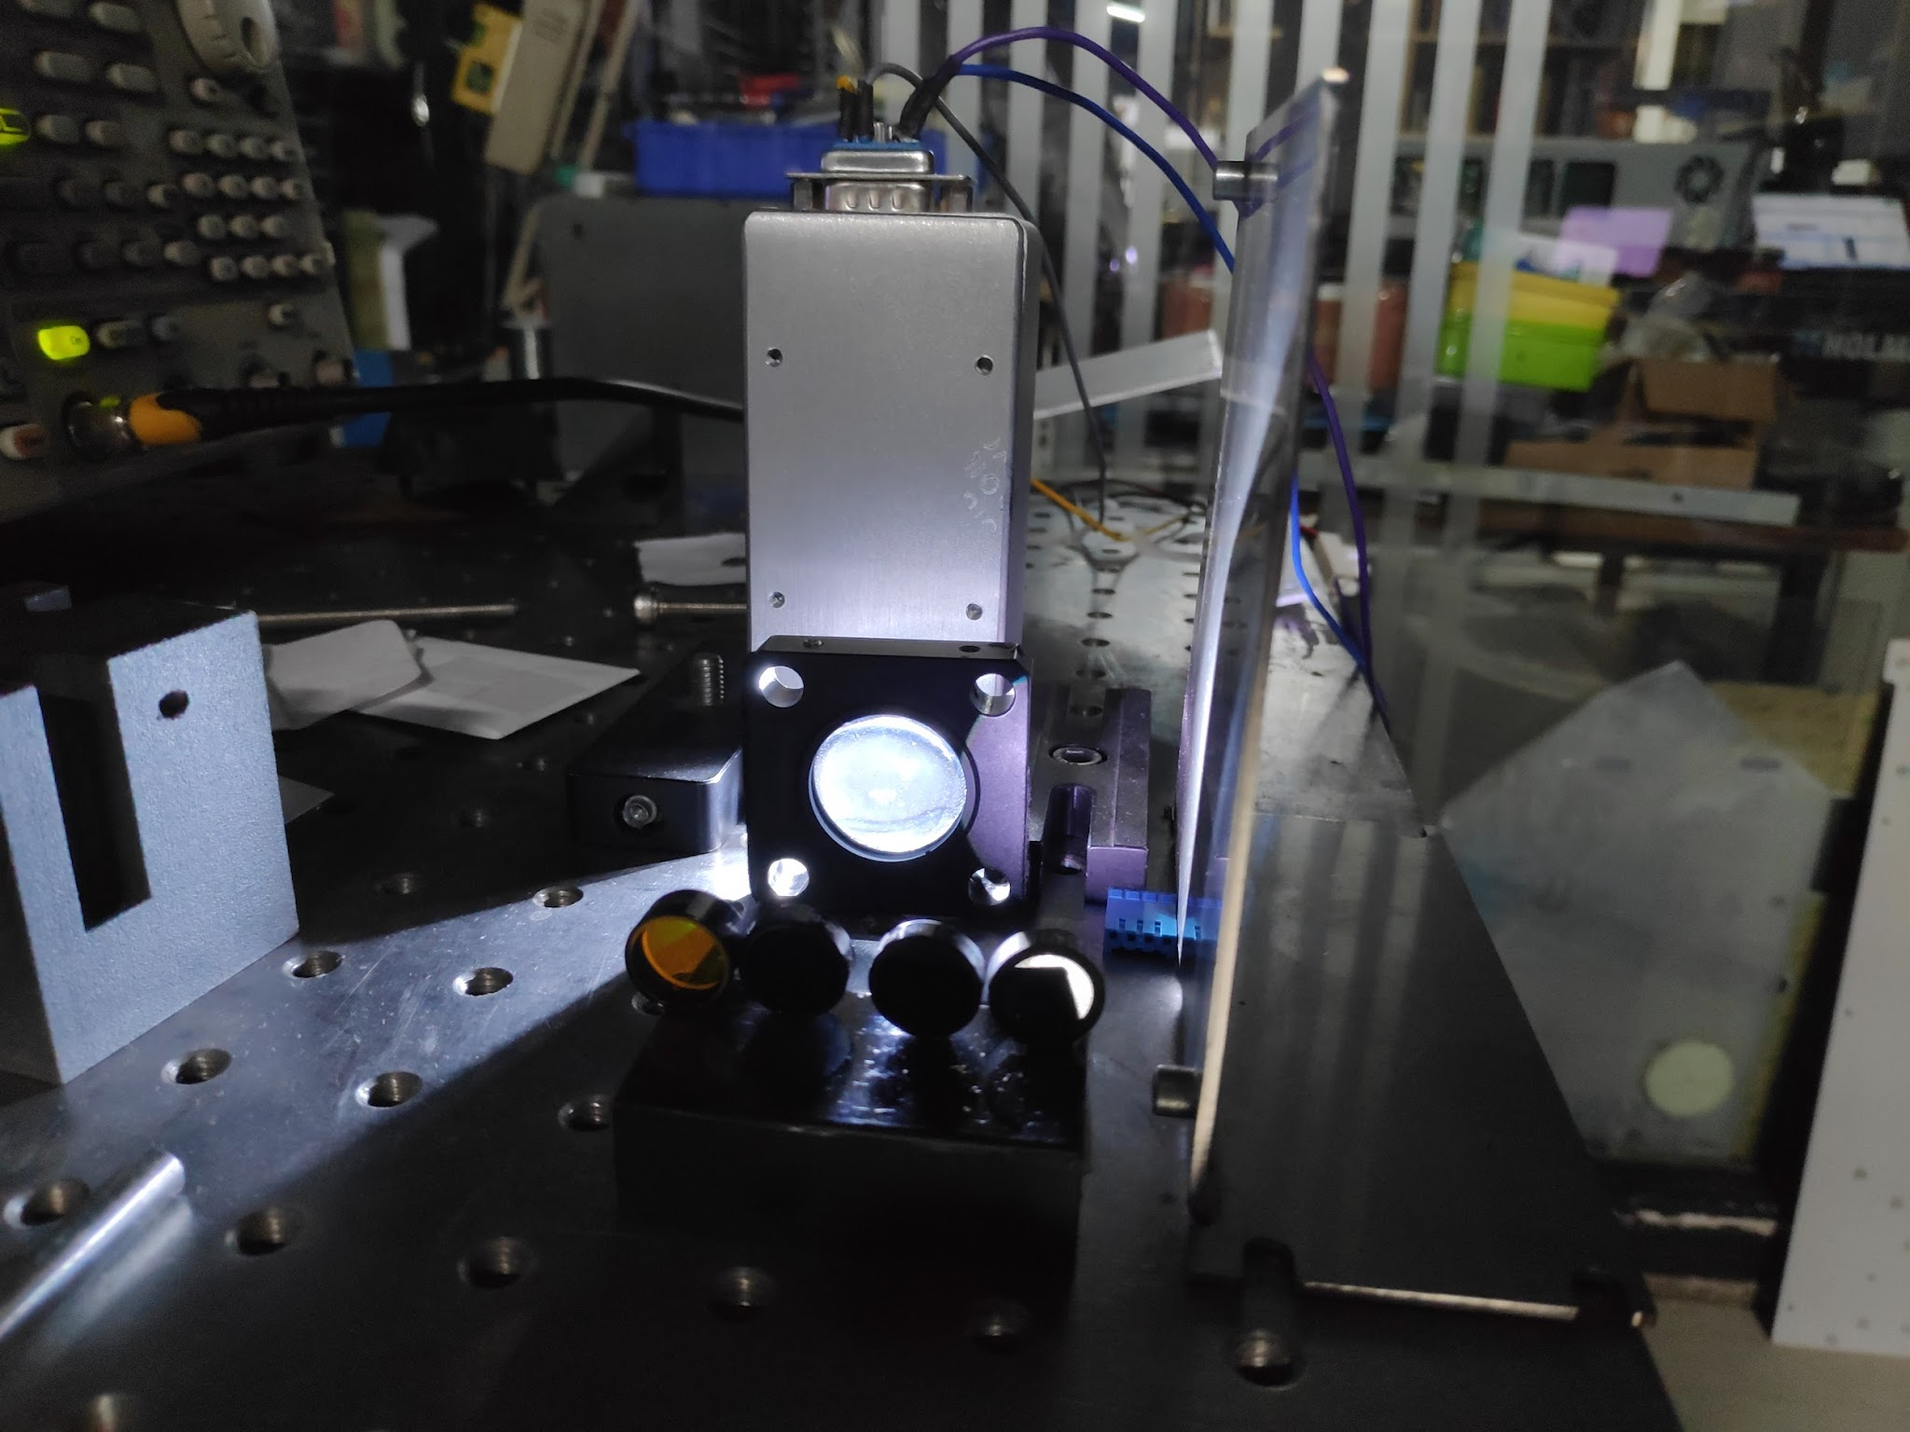
HASS (Highly Accelerated Stress Screening) Setup

Slide 12
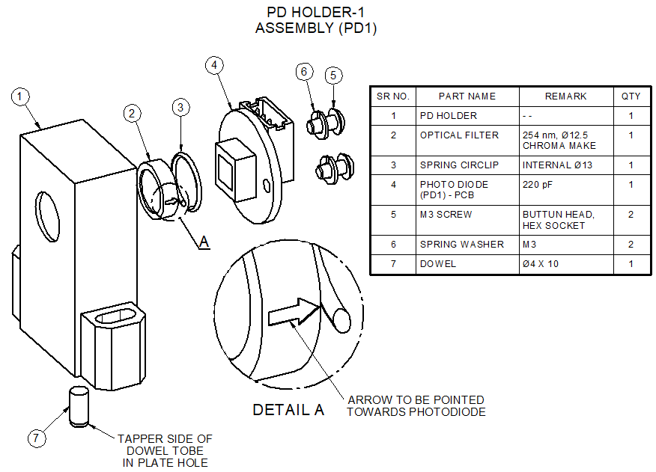
How to Assemble the Optical Filter in the PD Holder

Slide 13
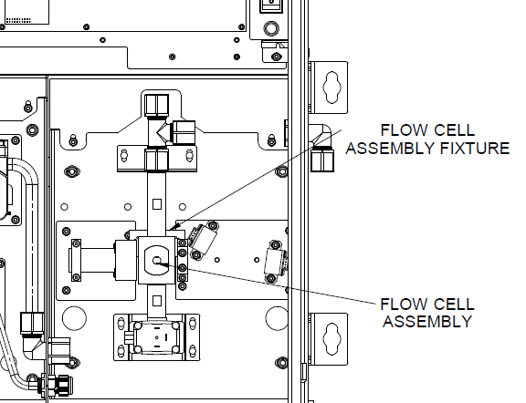
Tools for Optical Alignment
y
x

Slide 14
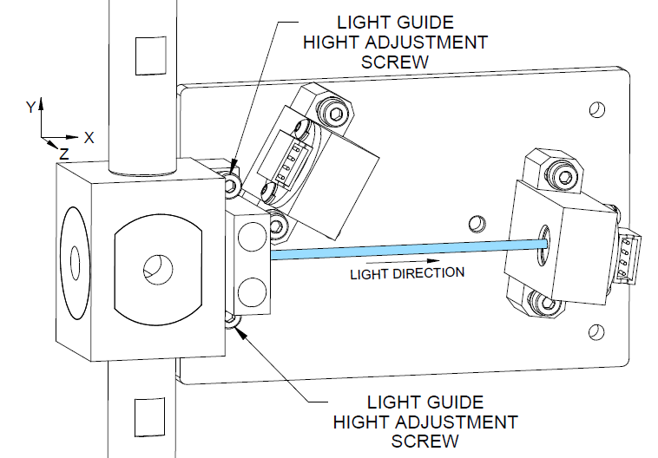
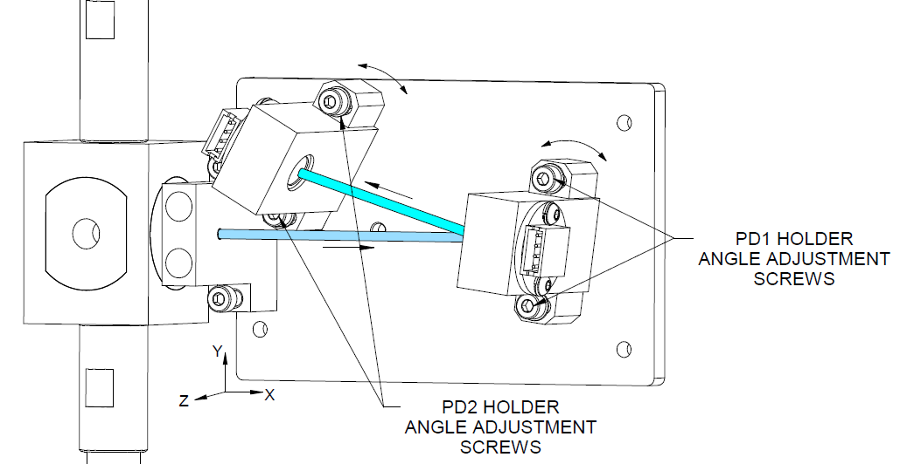
Adjusting light to fall on PD1 filter
Adjusting light to fall on PD2 filter

Slide 15
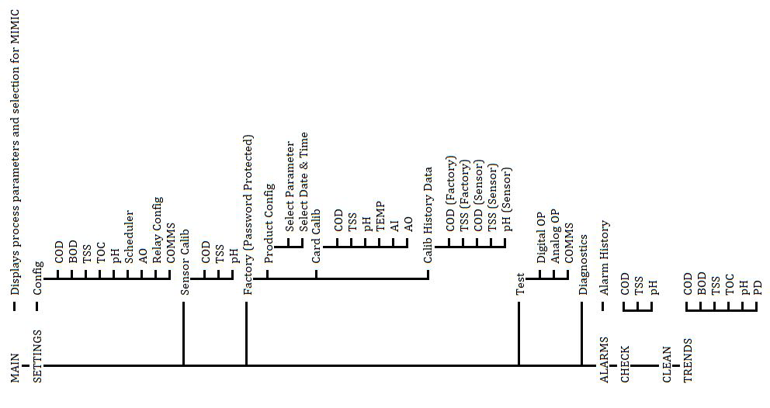
Menu Tree

Slide 16
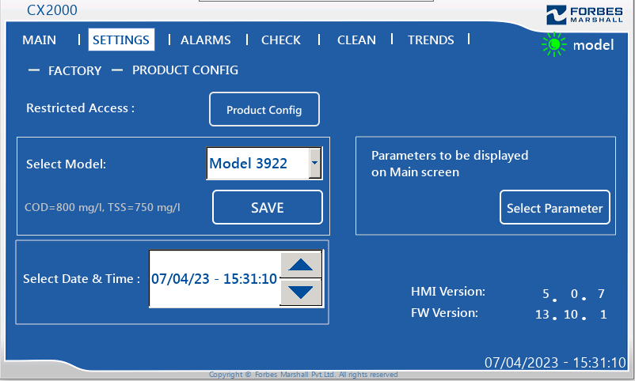
Product Configuration

Slide 17
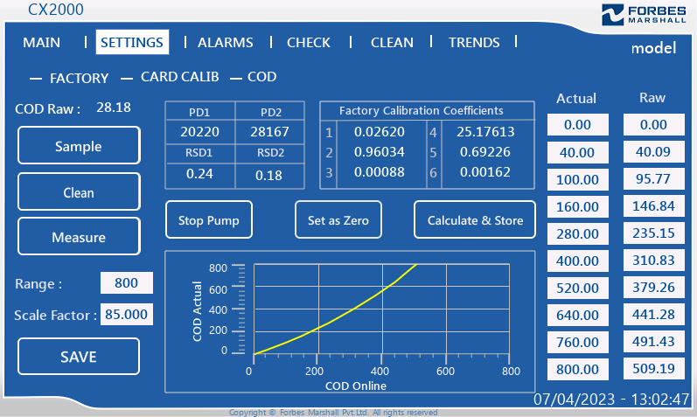
Default Graphs, Scale Factor, Unit, CF, Calibration Solution will automatically come on Selection of a particular Model

Slide 18

TSS Graph derived with Formazin (SigmaAldrich)

Slide 19
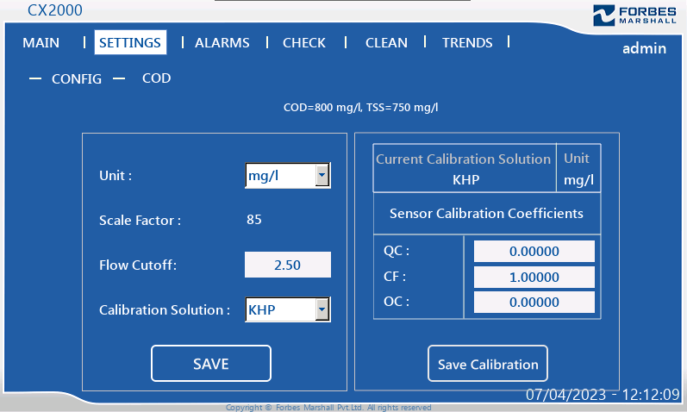
COD Configuration Screen

Slide 20
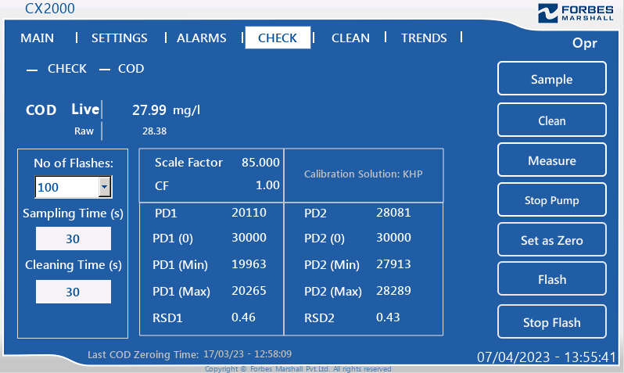
COD CHECK Screen

Slide 21
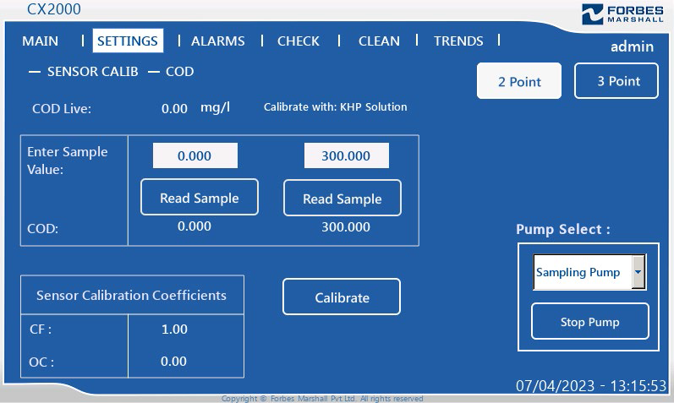
COD 2 Point Calibration

Slide 22
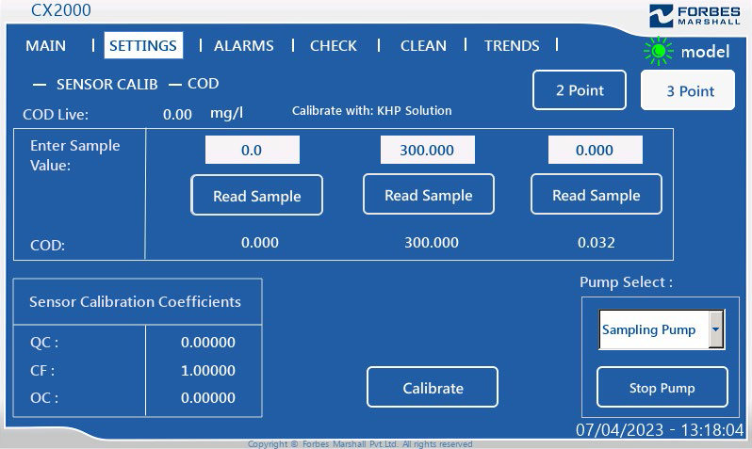
COD 3 Point Calibration

Slide 23
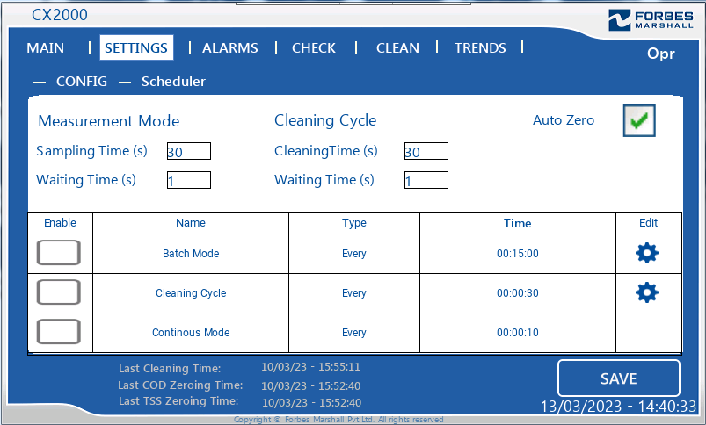
Scheduler Configuration

Slide 24
Scale Factor Calculation
Scale Factor is dependent on the Flow Cell Path Length
For the same model, Path Length slightly varies from Flow Cell to Flow Cell
So, Scale Factor needs to be recalculated if the Flow Cell is replaced by a new one
Formula for calculating Scale Factor:
New scale factor = Default scale factor x (COD Raw corresponding to the KHP Calibration Solution in Factory Calibration Table / COD Raw Reading)

Slide 25
Process Calibration with Actual Sample at Site
CX2000 is factory calibrated with the standard solutions for COD and TSS
As per the pollution control board guidelines for OCEMS, both of these parameters require regular process calibration at site for better matrix matching
Frequency of process calibration depends on the sample condition
For the process calibration, the sample should be given to a neat-equipped laboratory
The same grab sample should be kept for performing sensor calibration in CX2000

Slide 26
Switch between Standard Solution Calibration and Process Calibration
Default Calibration Solution is KHP Standard Solution for COD and Kaolin Standard Solution for TSS
Before performing Process Calibration, select Process as Calibration Solution in SETTINGS > CONFIG > COD / TSS
Again, if you want to check reading or calibrate with Standard Solution, select KHP / Kaolin as Calibration Solution in SETTINGS > CONFIG > COD / TSS

Slide 27
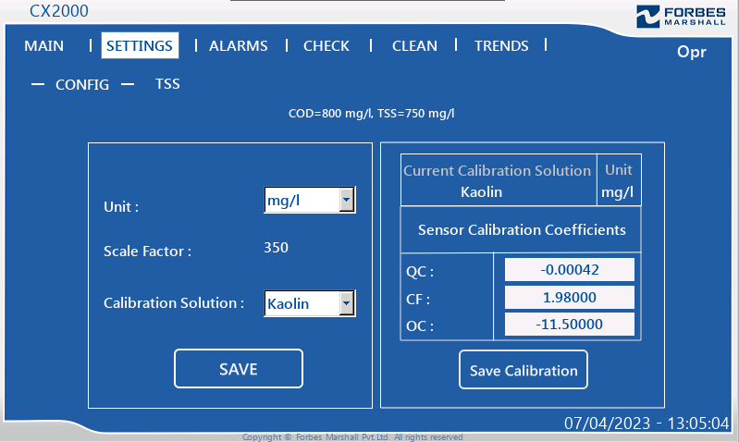
TSS Configuration Screen

